Slide 1


Infrastructure Surface Crack Detection
CS 7641 Team 34
Botao Li
Inshira Seshie
Kaiqin Bian
Lawrence Bradley
Qinghao Zeng

Slide 2
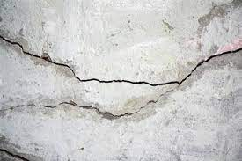
Introduction and Problem Definition
Surface cracks are superficial line-shaped damages in structures left unattended can cause greatly structural damage
However, manual inspection conducted by humans can be both time consuming and labor-intensive
Therefore our project aims to develop a machine learning model that is able to detect surface cracks and evaluate their severity to improve crack inspection methods

Slide 3

Crack Detection and Severity Evaluation Workflow
Step 1 - Visualize dataset and data information for pre-processing
Step 2 - Data pre-processing
Scale down image size
Apply edge detection
Balance the numbers of data (crack images and non-crack images)
Apply PCA to extract new features (not work well on our model, then it was deleted)
Split data into training set and validation set for training preparation
Step 3 - Model set up for supervised learning
PyTorch’s neural net module
Classification model
Step 4 - Model set up for unsupervised learning
GMM
DBSCAN
Step 5 - Results and analysis for both models

Slide 4
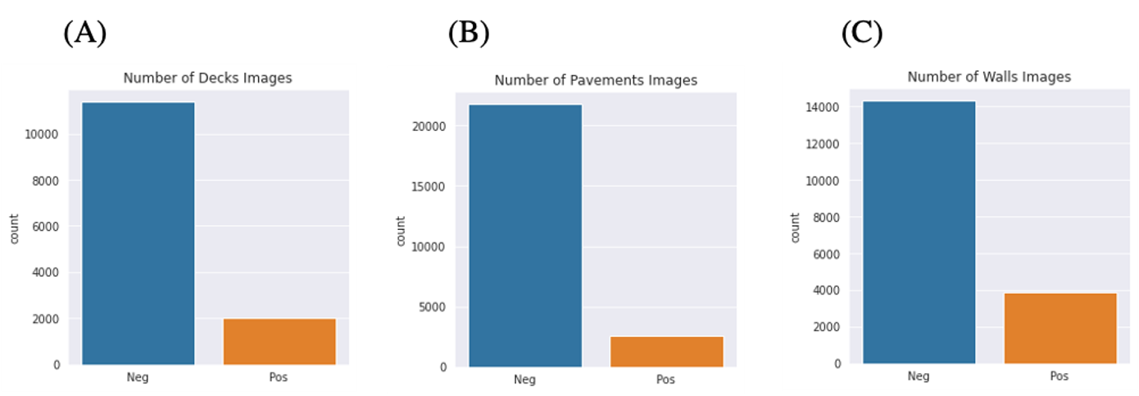
Methods: Data Collection and visualization
Dataset source: "Structural Defects Network 2018" (SDNET2018) from Kaggle.
https://www.kaggle.com/datasets/aniruddhsharma/structural-defects-network-concrete-crack-images
Description:
Context: 56,000 images of cracked and non-cracked decks, walls, and pavements. (Each image with a Ground Truth label for "Cracked" and "Non-cracked").
Visualization: non-cracked images # >> cracked images #.

Slide 5
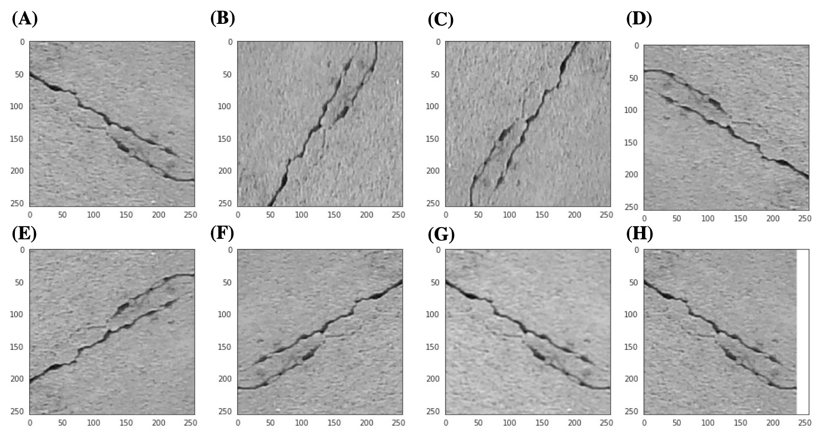
Methods: Dataset balancing
The following noises were added to crack images (Figure (A)).
2 types of rotates (B-C).
3 types of flips (D-E).
Other noises can also be added:
Blurring (F).
White-edge (G).
Noise images were generated into dataset without replacing original images:
Notes:
Do we need to mention negative influence of white edge to our training model?

Slide 6
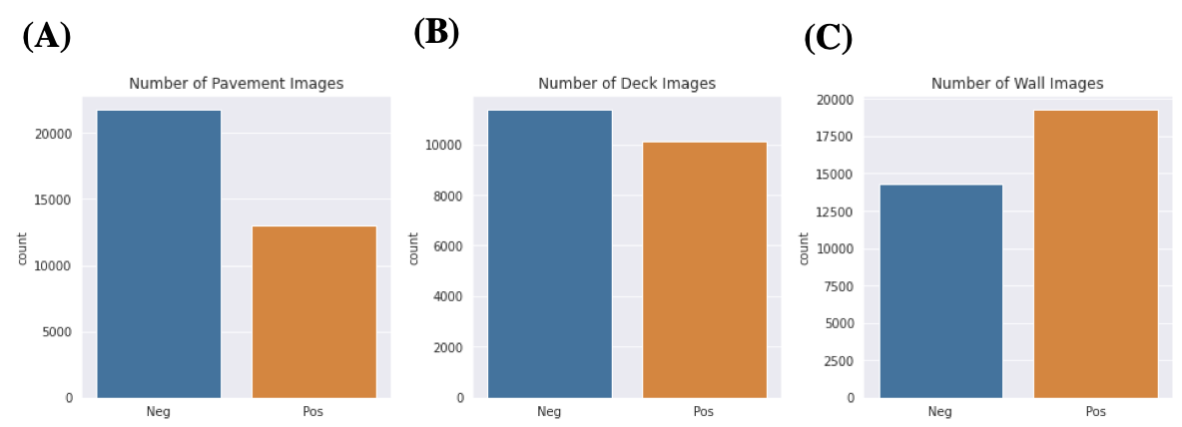
Methods: Dataset balancing
Crack image dataset increased by 5 times Dataset balanced

Slide 7
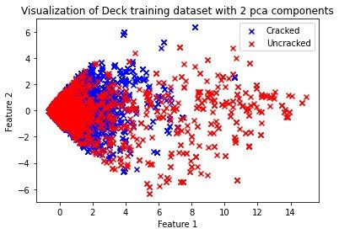
Methods: PCA
Problem: Difficulty in classification due to huge number of features.
Method: Principal Component Analysis (PCA).
Feature reduction: Only first 2 components are kept.
Total retained variance: 0.6919889 (0.63558196 and 0.056407 for each component).

Slide 8
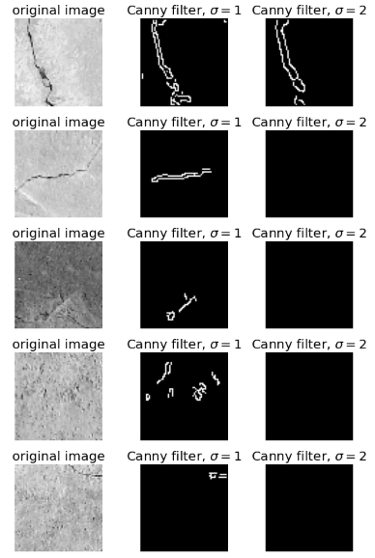
Methods: Edge detection
Problem: Difficulty in recognizing cracks correctly.
Method: Edge detection using Canny filter.
Results: Backgrounds are all black, cracks are marked white.

Slide 9
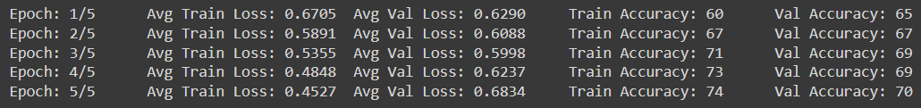
Methods: Classification Model
– Crack detection
Pytorch neural net as a classifier using a simple chain of 6 linear layers with Leaky ReLU activation functions (alpha = 0.01) and a sigmoid output.
The architecture was modified after we changed from using PCA to edge detection, such that our input dimension was now a flattened 64 * 64
Trained for 5 epochs with learning rate of 0.0001 with Adam optimizer

Slide 10
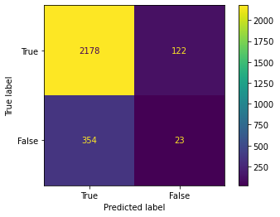
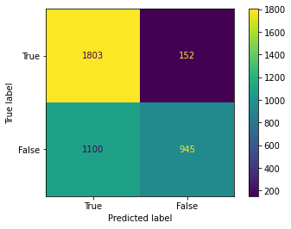
Results: Classification Model
 | Precision | Recall | F1-score | Support
Uncracked | 0.86 | 0.95 | 0.90 | 2300
Cracked | 0.16 | 0.06 | 0.09 | 377
Accuracy |  |  | 0.82 | 2677
Macro avg | 0.51 | 0.50 | 0.49 | 2677
Weighted avg | 0.76 | 0.82 | 0.79 | 2677
Before
 | Precision | Recall | F1-score | Support
Uncracked | 0.62 | 0.92 | 0.75 | 1955
Cracked | 0.86 | 0.46 | 0.60 | 2045
Accuracy |  |  | 0.69 | 4000
Macro avg | 0.74 | 0.69 | 0.67 | 4000
Weighted avg | 0.74 | 0.69 | 0.67 | 4000
After

Slide 11
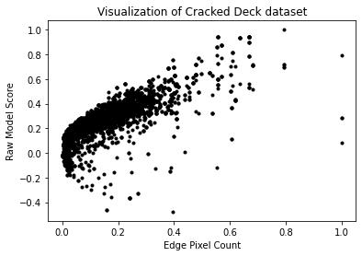
Normalization: Clustering Model – Severity Evaluation
Normalized two features:
Number of Edge Pixels,
Raw Model Score

Slide 12
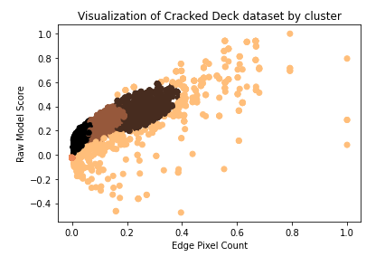
Methods & Results: Clustering Model – Severity Evaluation
GMM: the first choice to obtain soft-clustering results.
Input: Sigmoid output from NN.
Clusters: 4
Results: Further points -> cracks are more severe and obvious.
Silhouette Score: 0.6211911931086308
Davies-Bouldin Score: 2.396175298056523

Slide 13
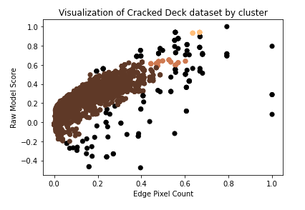
Methods & Results: Clustering Model – Severity Evaluation
DBSCAN: Handle clusters of multiple sizes and structures and is not powerfully influenced by noise or outliers.
Input: Sigmoid output from NN.
Clusters: 4
Parameters: epsilon=0.04, minPoints=10.
Silhouette Score: 0.625597181831163
Davies-Bouldin Score: 1.4289649052609

Slide 14
Thank you for listening!

